Slide 1
Steps to Wellbeing Wisdom
Lesson Plan (KS2)

Slide 2
Let’s talk about the Steps to Wellbeing Wisdom!

Slide 4
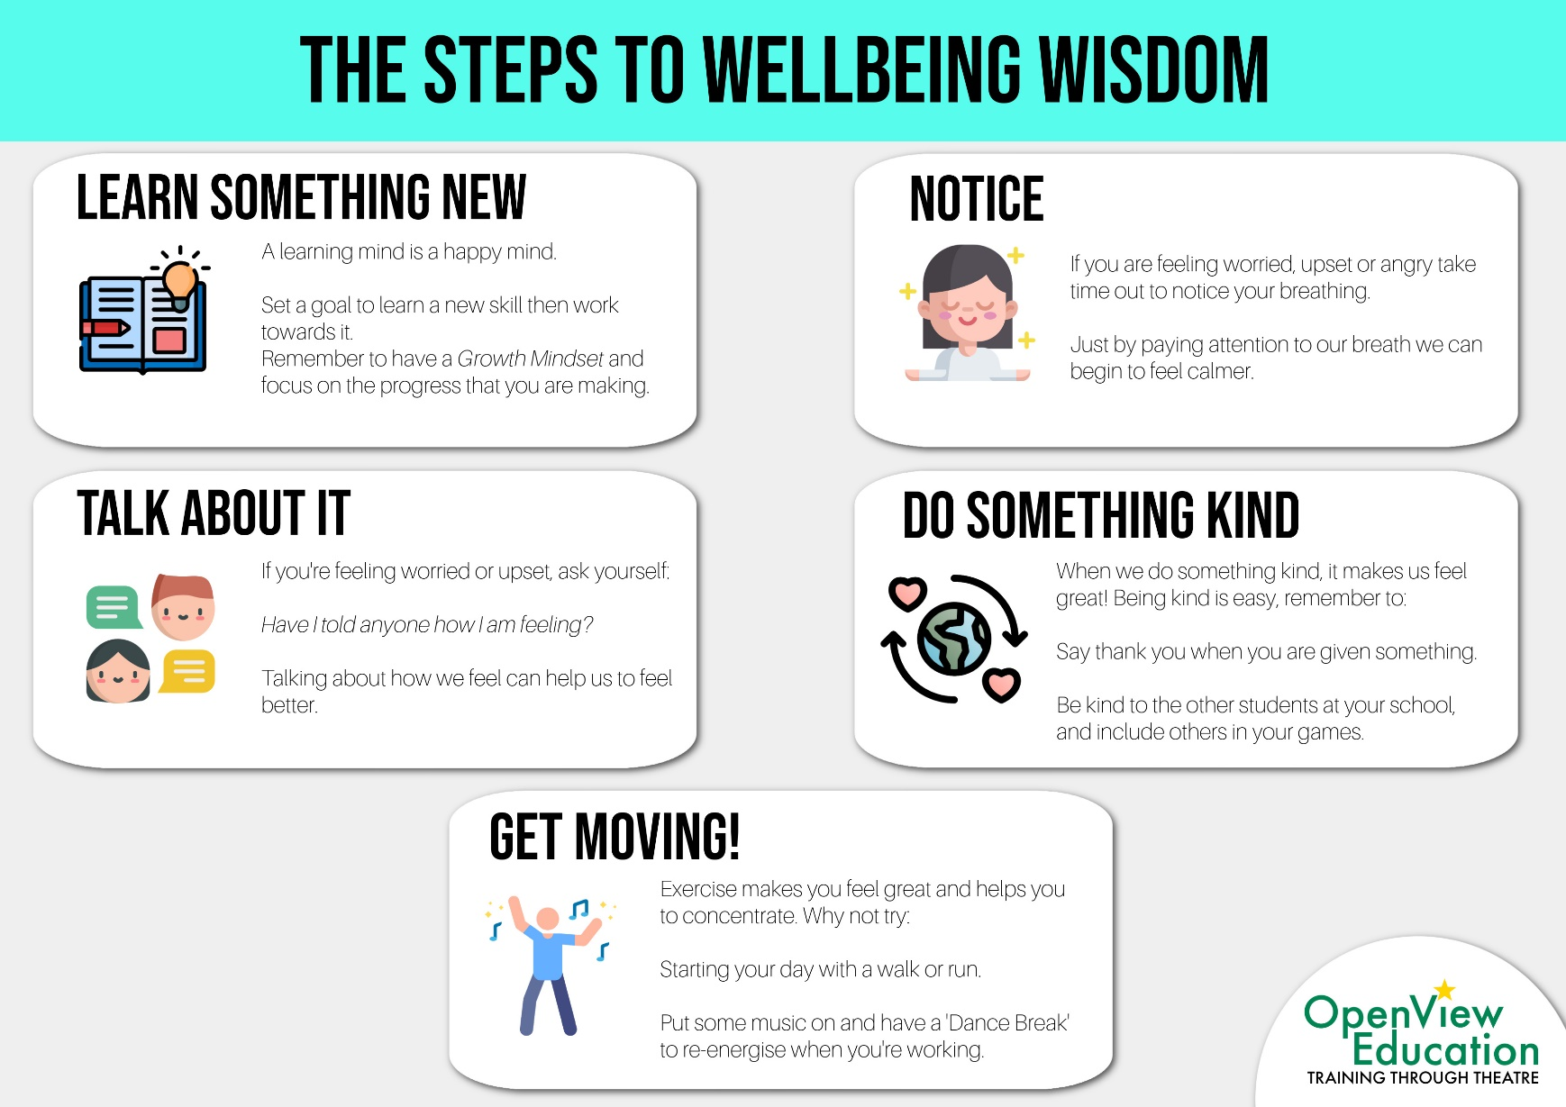
How could you use these steps in your life?

Slide 5
Write down three things that you could do for each of the steps!
Here’s an example:
Learn Something New:
I will learn a new word every week.
Do online research for my homework.
I will read a book before bed.

Slide 6
Now make your poster!
Remember:
Include all 5 Steps.
Write one activity for each step.
You can draw a picture for each step.

Slide 7
Now share your posters with the rest of the class!

Slide 8
Well done!

